Slide 1

Examination and recommendations for “coffee shop”
www.kaggle.com/ylchang/coffee-shop-sample-data-1113

Slide 2
core business of beverages
Not surprisingly for a coffee shop, beverages are their core business and account for:
• 79% of revenue, 88% of profits,
82% of quantity
• Highest profit margin of 71%

Slide 3
Support successful beverages
Very successful products (high revenue and typical % profit):
Barista Espresso
Gourmet brewed coffee
Brewed Chai Tea
Products with low profit margins:
Hot Chocolate
Seasonal drink
Note: Seasonal drinks may have been offered at low prices during the holidays to draw customers in

Slide 4
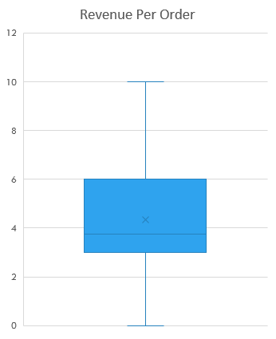
Protect core business of small transactions
Total Revenue
Transactions between ~$3 and $6 dollars account for roughly 50% of total revenue, and $3 - $6 corresponds to 1.4 items per transaction.
The coffee shop should ensure they do not lose their core business of small transactions by offering quick and accurate service and not overpricing. Increasing highly profitable add-ons (from previous slide), such as caramel syrup, could increase the revenue of small transactions.
$22,700
$59,700
$131,300
$20,400
Graphic ignores some outlier points above $10 dollars

Slide 5
Run promotions 11am to closing to drive business
Performance (revenue, profits, transactions) increases from when stores open to peak hours, which are between roughly 7:00 a.m. and 11:00 a.m.
Performance then remains steady at around 8000 items sold until it starts to fall off around 6:00p.m.
It appears business peaks when people get coffee in the morning and drops before lunch.
Running promotions to drive business during non-peak hours would increase revenue (if promotions were not too expensive). As it would be difficult to rebrand as a place for meals, perhaps market products as afternoon snacks or energy boosts.

Slide 6
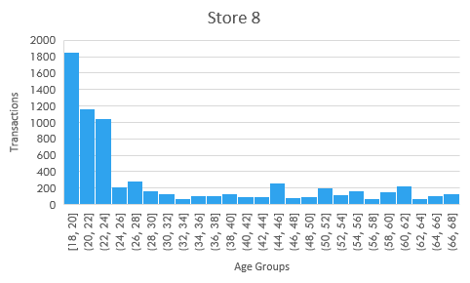
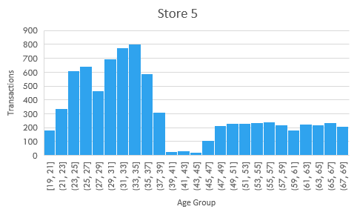
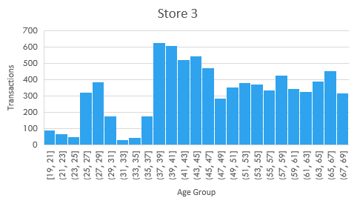
Target underperforming age groups at different stores
Age distributions for number of transactions vary widely from store to store
Target certain age groups that underperform:
Store 3: 19-37
Store 5: 19–21, 39-69
Store 8: 24-68 (particularly here)
The differences in age groups may in part be due to geographic location.
Although types of beverages purchased are not remarkably different per store (not shown), promotions in specific beverages, discounts for older customers, or discounts at certain times may encourage age groups to visit the shop.

Slide 7
Excel tools/functions used
Pivot tables
Pivot charts
Sum, Sumifs
Replace
Vlookup
Count, countifs
Index
Match
Median
Text
Round
Left, mid

